Slide 1
PHARMACY PERFORMANCE ANALYTICS DASHBOARD
USING TABLEAU
BY
MIRACLE LUKE
19th MAY, 2026

Slide 2
PROJECT OVERVIEW
Objective
This project was developed to analyze pharmacy sales performance, profitability, and product trends across different pharmacies and countries.
Goals
Analyze revenue and profit performance
Identify top performing countries and pharmacies
Evaluate product and brand performance
Track year-over-year growth
Track seasonal changes

Slide 3
BUSINESS QUESTIONS
Which pharmacies generate the highest revenue and why?
Which products are the most profitable and why?
Which countries generate the most revenue?
Are they seasonal patterns?
Which products are high-volume but low-margin and vice versa?
Is duration of existence a factor that contributes to revenue and profit?
Are products generating more revenue because of their brand?

Slide 4
DATASET OVERVIEW
Dimensions: Pharmacy name, product category, product brand, date, country, pharmacy type, pharmacy size
Measures: sales, profit, units sold, profit ratio
Data Preparation
Created calculated fields
Built YoY calculations
Developed top 10 ranking filters
Created parameter filter

Slide 5
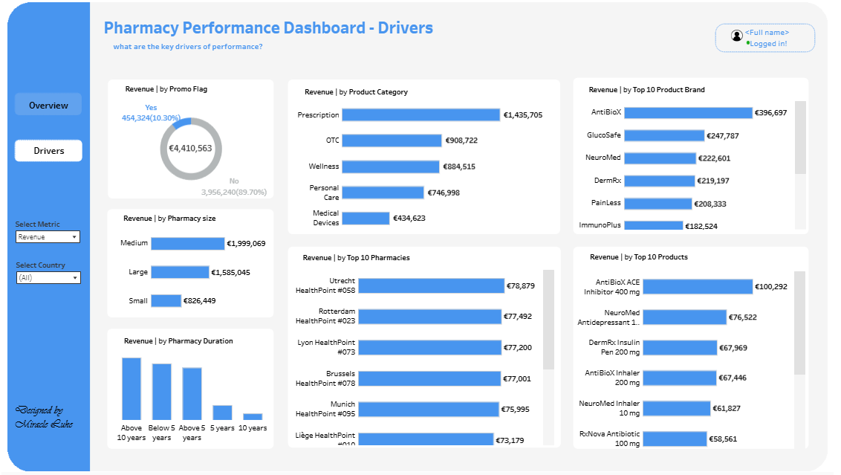
DASHBOARD FEATURES
Dynamic metric selection
Interactive filter
Top 10 analysis
Year-over-Year comparison
KPI cards
Dashboard Link
View dashboard

Slide 6
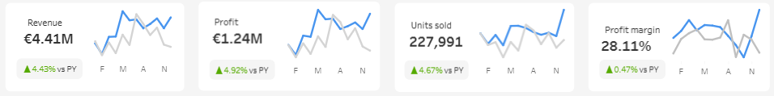
KPI SUMMARY
Revenue
Profit
Units Sold
Profit
Margin

Slide 7
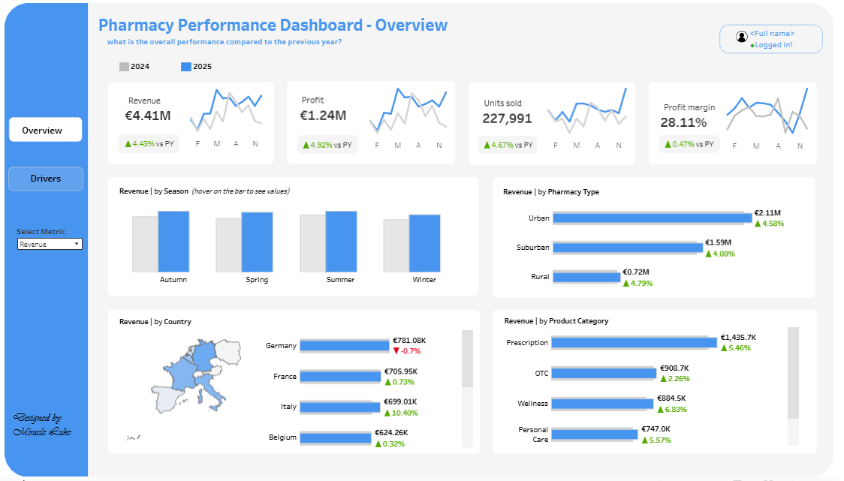
YEAR-OVER-YEAR PERFORMANCE INSIGHTS
Findings
Top selling product category vs previous year
Top countries vs previous year
Monthly trend vs previous year
Top performing pharmacy type vs previous year

Slide 8
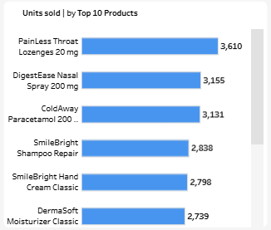
PRODUCT INSIGHTS
Top selling products
Most profitable product
Most profitable brands
High-volume and Low-margin products
Low-volume and High-margin products

Slide 9
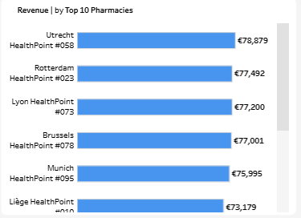
PHARMACY INSIGHTS
Findings
Top performing pharmacy
Top performing pharmacy type
Top performing pharmacy size

Slide 10
RECOMMENDATION
Increase focus on high-margin and high-volume products
Monitor YoY growth regularly
Improve Performance of Smaller Pharmacies
Increase Investment in Prescription Products
Focus on High-Performing Product Brands
Expand High-Performing Pharmacy Types

Slide 11
CONCLUSION
The dashboard reveals that revenue growth is primarily driven by prescription products, high-performing urban pharmacies, and a few dominant product brands. By optimizing promotions, improving smaller pharmacy performance, and expanding successful operational strategies, the business can improve both revenue growth and profitability.

